Slide 1



sonargoan University
Snake
Game
with AI Opponent
Artificial intelligence

Slide 2


1
OUR MEMBERS
1
Ayon Debnath
CSE2201025009
Jahangir Hussen CSE2201025011
2
3
Md Shawon Ali
CSE2201025089
Jubayed Ahmed Efty
CSE2201025068
4
Nowrin Akter
CSE2201025054
5
Mst. Kohily CSE2201025038
6

Slide 3
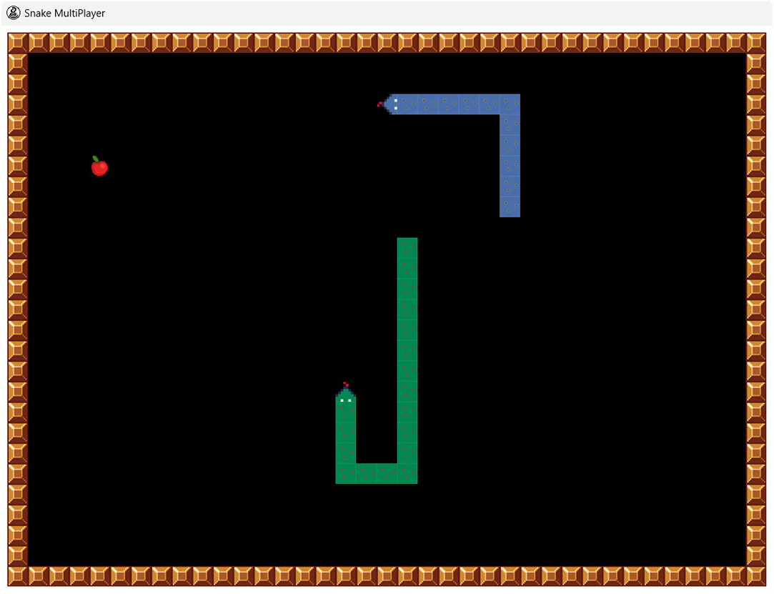
Introduction
2
What is the Snake Game?
A classic arcade game where the player controls a snake that grows by eating food.
Objective
Compete against an AI-controlled snake to eat more food and survive the longest. The game ends when a snake crashes.
snake game
Why AI?
AI adds competition, making the game more challenging and engaging. The player must race against the AI, creating a more dynamic and unpredictable experience.

Slide 4





3
Motivation Behind Choosing This Game
Personal Interest:
Learning Experience:
Learning Experience:
Challenge & Fun:
Inspired by the classic Snake game.
Apply Python programming and Pygame skills.
Implement basic AI movement logic.
Wanted to create a game where AI competes with a human.

Slide 5

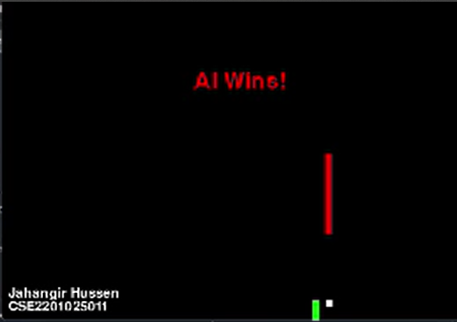
4
Game Description
Basic Rules of the Game:
AI
Human
✔ The goal is to eat the fruit and grow longer.
✔ The game ends if a snake hits the wall or itself.
✔ The snake that survives longer wins.
Role of the Human Player:
AI Wine!
🎮 Controls the snake using arrow keys.
🎮 Avoids crashing into walls or itself.
🎮 Tries to eat more fruits than the AI.

Slide 6
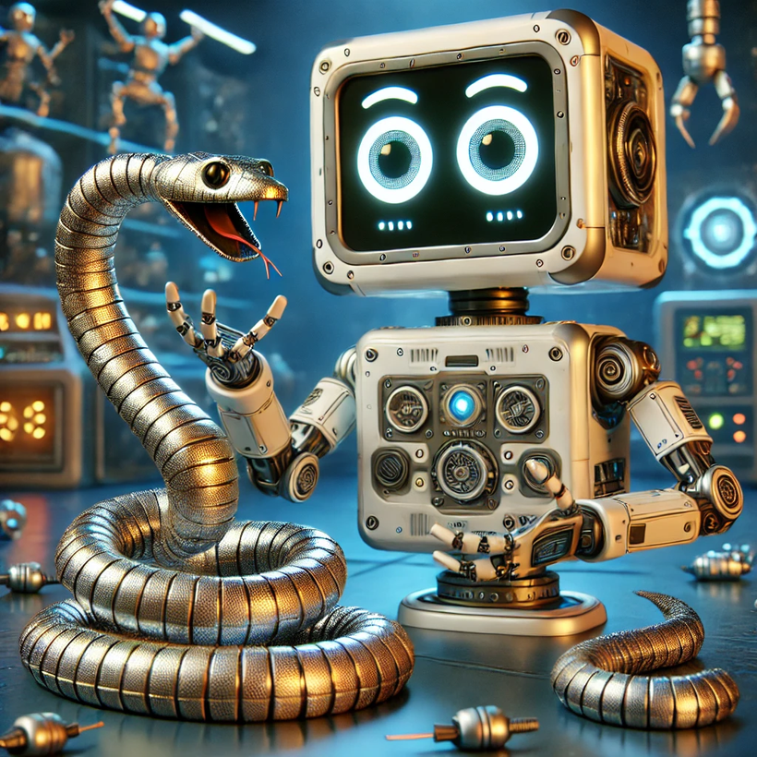
5
Game Description
Role of the AI Player:
🤖 Moves automatically toward the fruit.
🤖 Uses basic pathfinding logic.
🤖 Competes with the human to eat the fruit first.

Slide 7
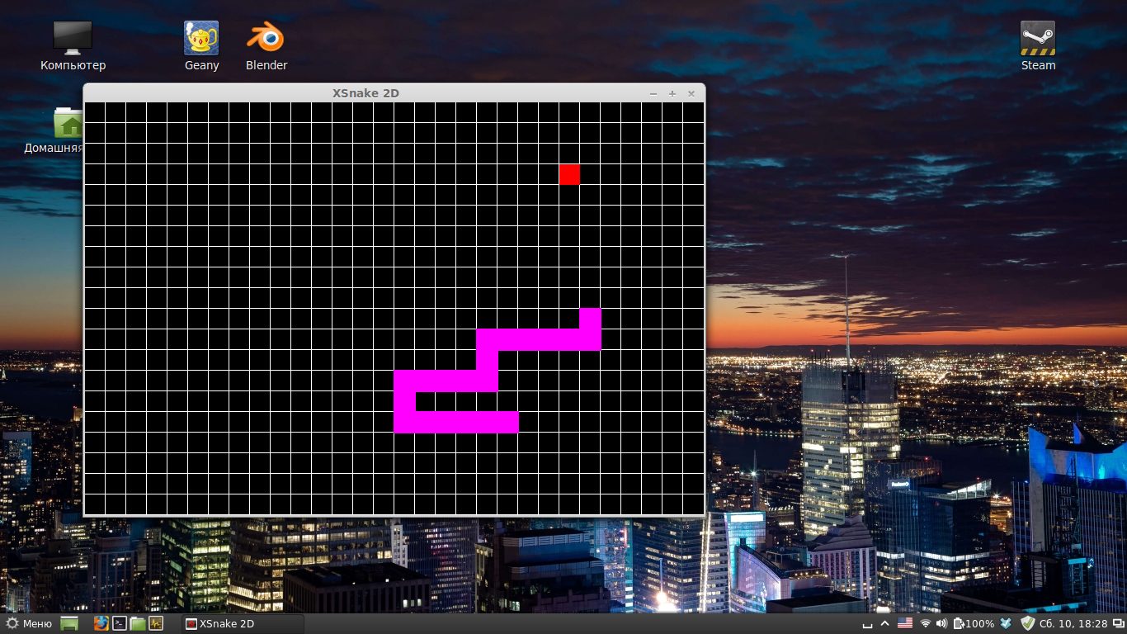
6
Unique Aspects of Our Game
Human vs. AI Competition
The AI actively competes for food.
Dynamic AI Movement
AI adapts based on fruit position.
Real-Time Score Tracking
Displays scores for both players.
win 10
snake game
Game Over Conditions for Both Players
AI can also lose!

Slide 8

7
Conclusion
What We Learned:
✔ Python programming and game development using Pygame.
✔ Implementing AI logic in a simple yet effective way.
✔ Managing real-time game mechanics (movement, collisions, scoring).
Future Improvements:
🔹 Smarter AI (path optimization, obstacle avoidance).
🔹 Multiplayer Mode (compete with another human).
🔹 Different Levels & Obstacles.

Slide 9

Thank you

